Slide 1
Chapter 9 Coping with NPC
School of Science, Yanshan University
Wang Gang

Slide 2
Coping with NP-completeness
Facing a new computational problem, you may try to
transform it into a known problem;
design a new algorithm, using divide-conquer, DP…;
prove that it is NP-completeness.
NPC is not an end, but the beginning of a fascinating adventure.
Average case complexity;
Smoothed complexity;
Restricted subproblems, such as Horn SAT;
Parallel algorithms;
Randomized algorithms;
Parameterized algorithms;
Approximation algorithms;
Intelligent exhaustive search algorithms;
Heuristic algorithms;
Quantum algorithms; ……

Slide 3
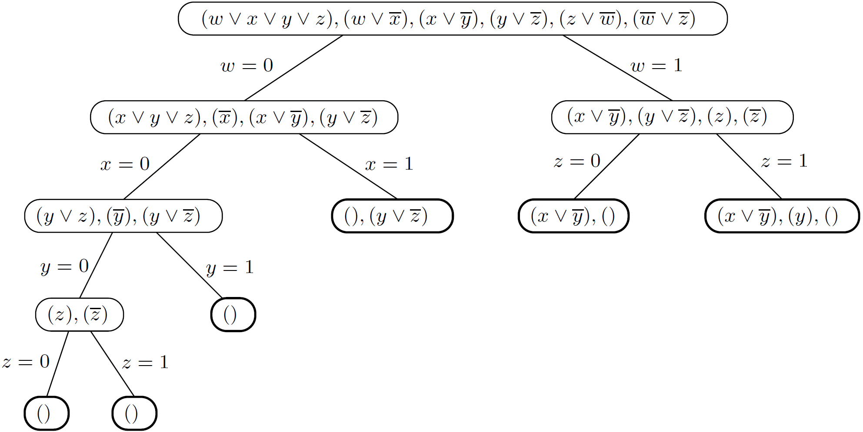
Backtracking - Reject a solution by looking part of it
SAT: (x₁∨ x₂) ∧ ∙∙∙. All assignments with x₁= x₂= 0 are not feasible.
Each node contains clauses still unsatisfied by the partial assignment so far. The empty clause () can never be satisfied.

Slide 4
Backtracking - Reject a solution by looking part of it
Backtracking: If the solution is a n-dimensional vector, after considering all the cases, backtracking finds a feasible solution.
Construct a search tree incrementally. Each branching node corresponds to a partial solution, and also a subproblem. Each leaf node corresponds to a complete solution.
Start searching from the root and try all reachable nodes. Step back one or several steps if necessary, and restart searching.
The search tree may be traversed in multiple ways, such as DFS, BFS.
Prune at the right time to accelerate searching.
During the construction of the search tree, need to make decisions:
which partial solution to expand? (DFS, BFS)
which component of the current partial solution to expand?

Slide 5
Backtracking - Reject a solution by looking part of it
A backtracking algorithm requires a test that looks at a partial solution and quickly declares one of three outcomes:
1. Failure: the partial solution can not be expanded into a full solution.
2. Success: a solution is found.
3. Uncertainty.
Start with some problem P₀
Let S = {P₀}, the set of active subproblems
repeat while S is nonempty:
choose a subproblem P∈S and remove it from S
expand it into smaller subproblems P₁, P₂ ,…, P_{k}
for each P_{i}:
if test(P_{i}) succeeds: halt and announce this solution
if test(P_{i}) fails: discard P_{i}
else: add P_{i} to S
Announce that there is no solution

Slide 6
Branch and Bound - Find an optimal solution
BnB is a particular kind of backtracking search algorithm for optimisation problems. The best solution found so far is used to prune portions of the search tree, based upon an over-estimate (the bound function) of the best possible solution within an unexplored portion of the search tree.
Where is the pruning?
Start with some problem P₀
Let S = {P₀}, the set of active subproblems
bestsofar = ∞
repeat while S is nonempty:
choose a subproblem P∈S and remove it from S
expand it into smaller subproblems P₁, P₂ ,…, P_{k}
for each P_{i}
if P_{i} is a complete solution: update bestsofar
else if lowerbound(P_{i}) < bestsofar: add P_{i} to S
return bestsofar

Slide 7
Branch and Bound - TSP
A partial solution R=[a, S, b] for TSP: a Hamiltonian path form a to b in the vertex set S, which is part of a feasible solution (Hamiltonian cycle).
Choose a∈V arbitrarily, then start searching from [a, {a}, a].
Extend R=[a, S, b] by an edge (b, x), where , and get [a, S∪{x}, x]. (≤ |V−S| ways).
How to lower-bound the cost of a Hamiltonian cycle H containing R?
len(H) ≥ lb = len(R) + dist(b, V−S) + len(MST(V−S)) + dist(V−S, a)
If lb ≥ bestsofar, do not expand R.

Slide 8
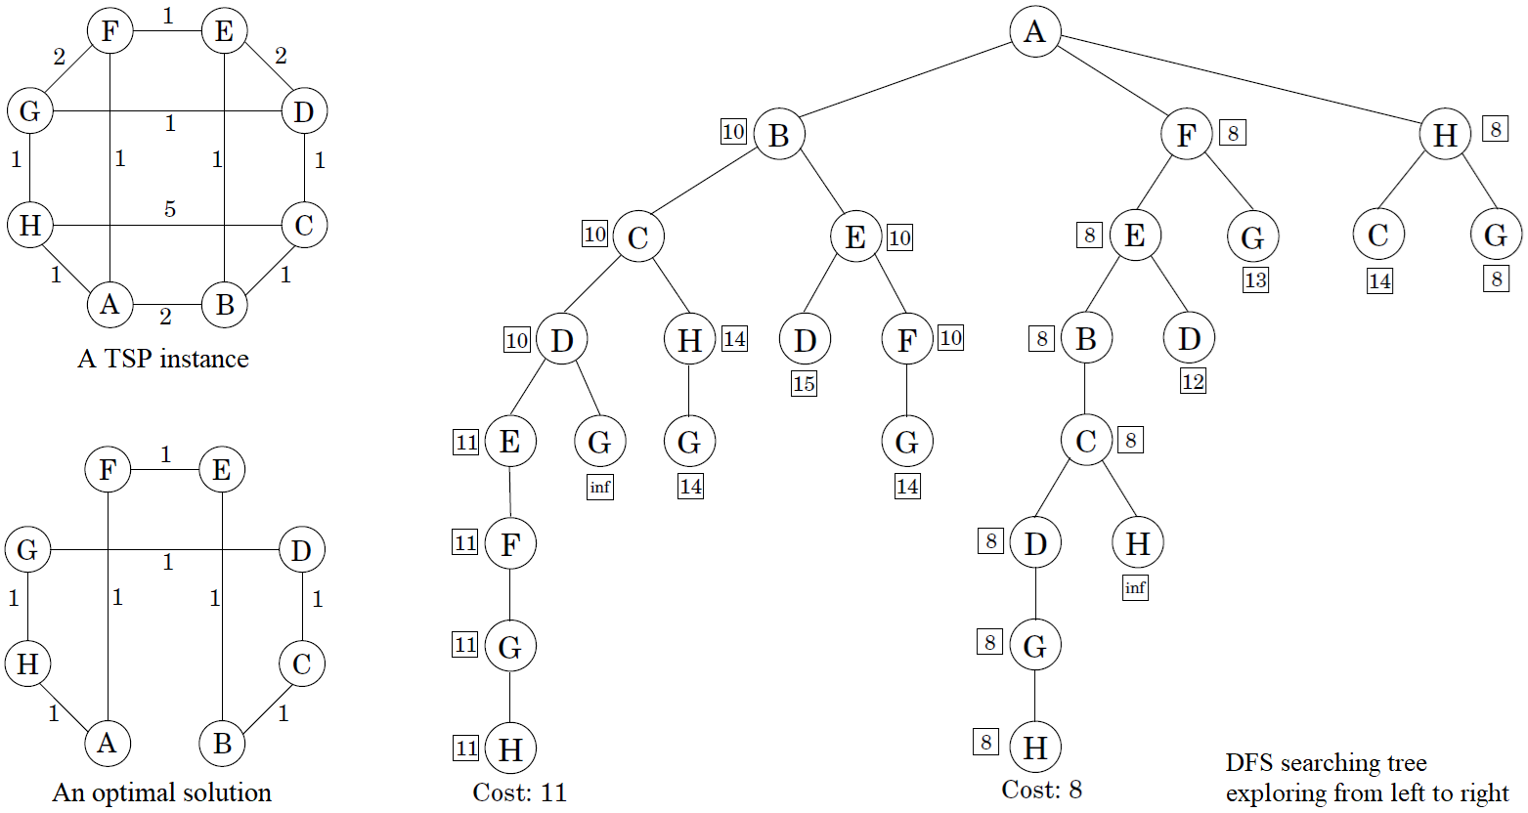
Branch and Bound - TSP
Each node of the tree represents the path from the root to that node.
Node C: S={A,B,C}. len(R=A↔B↔C)=3, len(MST(V−S))=5,
dist(C, V−S)=1, dist(V−S, A)=1. lb=3+5+1+1=10. bestsofar = ∞.
Notes:
在已知besrsofar=11的情况下，
为何从lb=14的ABCH扩展为ABCHG？
可以避免吗？

Slide 9
Approximation algorithms
Approximation ratio:
An approximation algorithm runs in poly(n) time.
Vertex Cover: Cover all edges with the least number of vertices.
VC is a special case of Set Cover.
Chapter 5 shows that SC∈APX(logn), so VC∈APX(logn). (tight ratio)
Repeatedly pick the vertex of highest degree left so far.
Matching: a set of independent edges. Maximal Matching∈P.
One vertex covers at most one matching edge.
|minimum vertex cover X| ≥ |maximal matching M|
S ={vertices saturated by M} is a vertex cover.
|S| = 2|M| ≤ 2|X|
VC∈APX(2). (tight ratio)

Slide 10
Approximation algorithms
k-Cluster: Cover a point set with k identical disks, the smaller the better.
Input: Points X={x₁,…,x_{n}} with underlying metric d(∙,∙), integer k.
Output: A partition of X into k clusters C₁,…,C_{k}.
Goal: Minimize the diameter of the clusters,
k-Cluster∈APX(2):
Iterate once more, get u₁, …, u_{k}, u_{k+1}= x.
Let r = min_{i∈{1,..,k}}d(u_{i}, x). Then diameter ≤ 2r.
The k+1 points are all at a distance at least r from each other. Any k clusters must put two of them in the same cluster. So diameter ≥ r.
Pick any point u₁∈X as the first cluster center
for i = 2 to k
Let u_{i} be the point in X that is farthest from u₁, …, u_{i−1}
(i.e., that maximizes min_{j<i} d(∙, u_{j}))
Create k clusters: C_{i} = {all x∈X whose closest center is u_{i}}

Slide 11
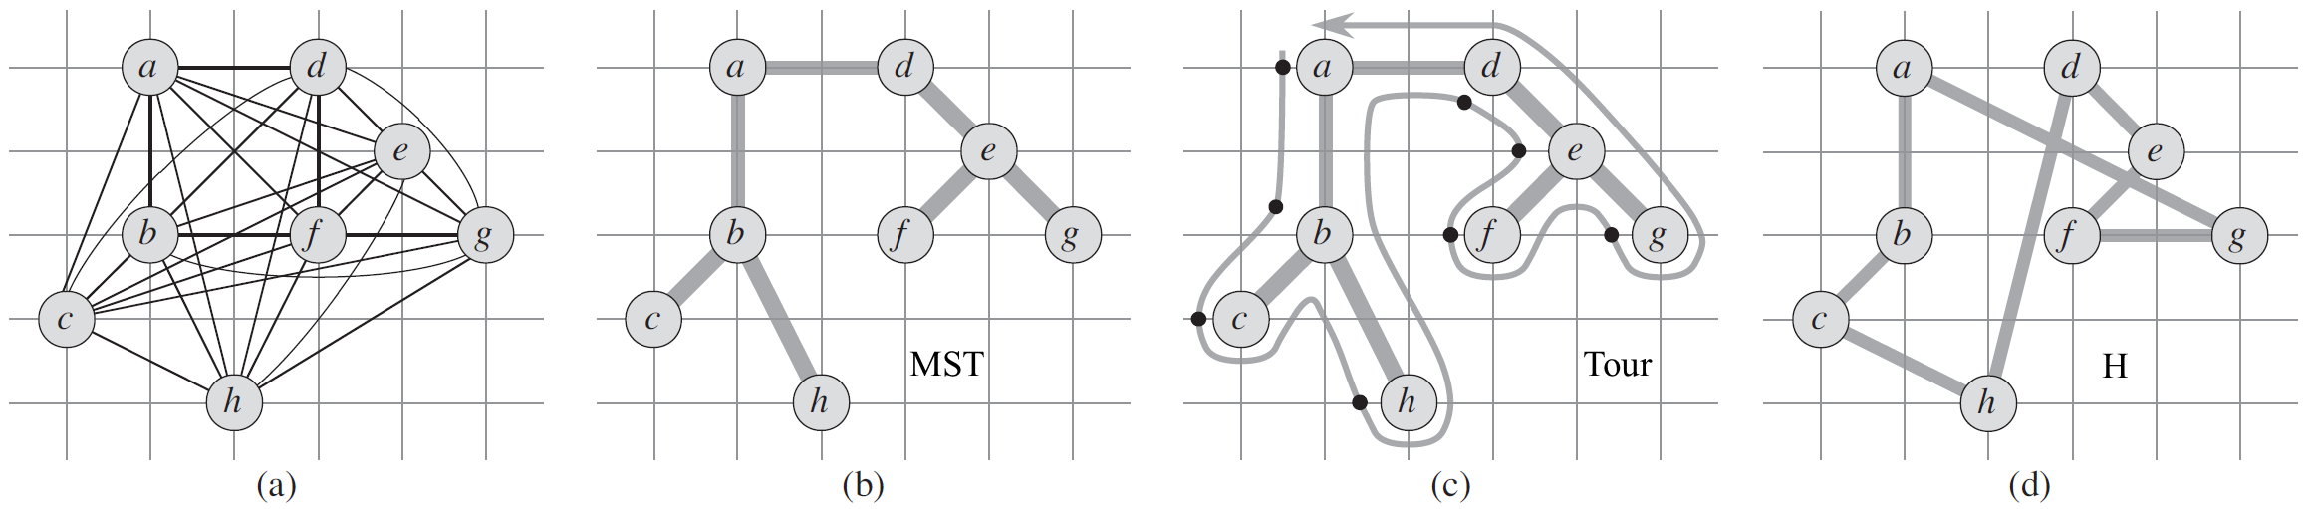
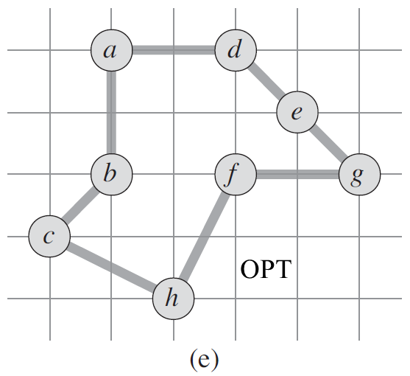
Approximation algorithms
Metric TSP: The double-tree algorithm.
Metric TSP∈APX(2):
Removing any edge from OPT, get a spanning tree T.
cost(MST) ≤ cost(T) < cost(OPT)
Circling around MST, get an Euler Tour. (DFS or Fleury).
cost(Tour) = 2cost(MST)
Skipping any vertices have visited, get a Hamiltonian cycle H.
cost(H) ≤ cost(Tour) (triangle inequality)
So cost(H) ≤ cost(Tour) = 2cost(MST) < 2cost(OPT).
Notes:
DFS可绕树一圈找出一条欧拉迹。此处恰合适。
Fleury算法可于一般图中找出一条欧拉迹。

Slide 12
Approximation algorithms
Inapproximability: If P ≠ NP, ∀α_{A} ≥1, TSPAPX(α_{A}).
Proof. Reduce the HC instance G = (V, E) to a TSP instance G'=(V, E', l).
G has a Hamiltonian cycle ⇒ the same cycle in G' is a tour of length n.
Otherwise ⇒ all Hamiltonian cycles in G' have length ≥ n(α_{A}+1).
Suppose TSP has an algorithm A with approximation ratio α_{A}, run A on G'. If OPT_{A}(G') = n, then G has a Hamiltonian cycle. Otherwise, G has not.

Slide 13
Approximation algorithms
PTAS: A polynomial-time approximation scheme is a family of algorithms {A_{ε}}, where there is an algorithm for each ε > 0, such that A_{ε} is a (1+ε)-approximation algorithm.
Knapsack: n items of weights w₁, …, w_{n}, values v₁, …, v_{n}. Find the most valuable combination of items that can be fit into a bag of capacity W?
Knapsack∈O(nW)  Knapsack∈O(nV), V = Σ_{i}v_{i}. (DP)
Knapsack∈PTAS:
Discard any item with weight > W
Let v_{max}= max_{i} v_{i}
Rescale values
Run the dynamic programming algorithm with values { } Output the resulting choice of items

Slide 14
Approximation algorithms
Knapsack∈PTAS.
Ratio 1/(1−ε): Let S be an original optimal solution, with total value K*.
Complexity:
Discard any item with weight > W
Let v_{max}= max_{i} v_{i}
Rescale values
Run the dynamic programming algorithm with values { } Output the resulting choice of items
Notes:
以 …… 为单位划分区间[0,V]，各物品价值以新单位向下取整。运行动态规划算法，所得最优解作为原始问题的近似解。
在新的缩小后的物品价值下，新的最优解只会比原始物品价值下的最优解S更好。

Slide 15
Approximation algorithms
Approximability: lower bounds on approximation ratios (If P ≠ NP).
NPC optimization problems are classified as follows:
∈PTAS: Knapsack
∈APX(c): Vertex Cover, k-Cluster, Metric TSP
∈APX(log n): Set Cover
: TSP
If P = NP, all NPC problems can be solved exactly in polynomial time. Then approximation algorithms are not funny any more!
Approximation algorithms often perform much better on typical instances than their worst-case approximation ratio.

Slide 16
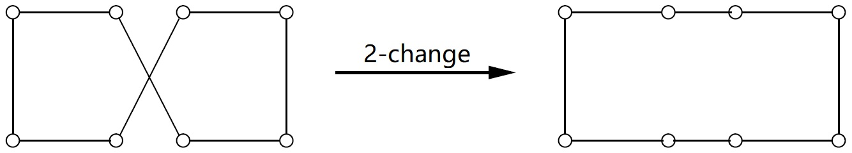
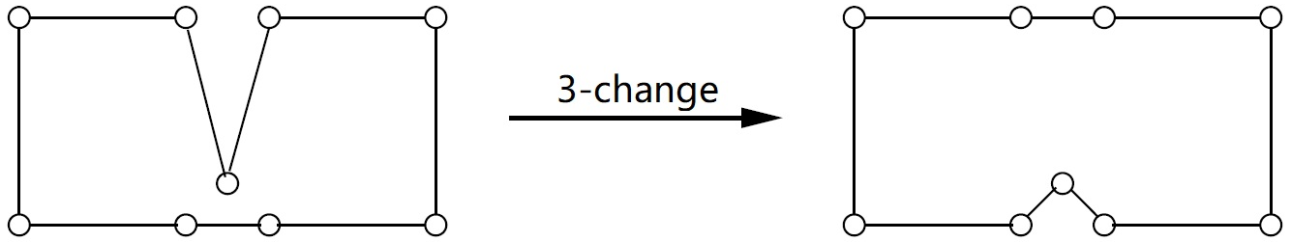
Local search heuristics
Local search: Mimic evolution. Introduce small mutations, try them out, and keep them if they work well.
TSP: (n-1)/2! feasible solutions.
2-change, O(n²) neighbors
3-change, O(n³) neighbors
let s be any initial solution
while there is some solution s' in the neighborhood of s
for which cost(s') < cost(s): replace s by s'
return s
Notes:
局部搜索的运行时间无保证，解的品质无保证，但实际运行效果经常不错。

Slide 17
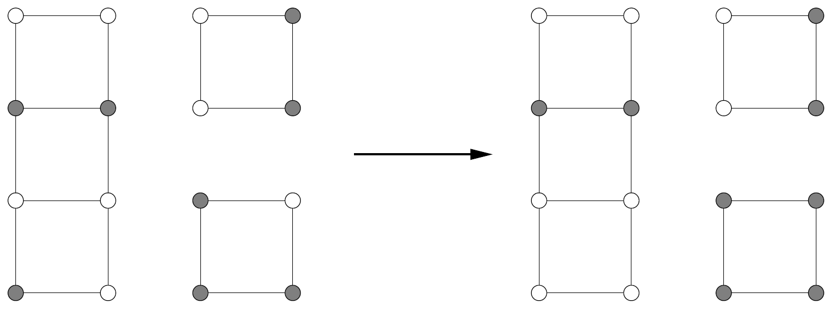
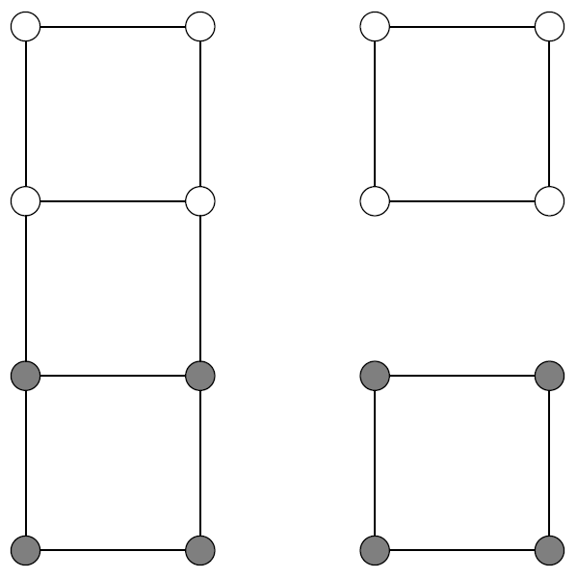
Local search heuristics
Balanced Cut (Graph Partitioning)
Input: Undirected graph G=(V, E), nonnegative weights, α∈ (0, ½].
Output: Partition V into A and B, each of size at least α|V|.
Goal: Minimize the capacity of the cut (A, B).
Balanced Cut ∈ NP-hard. Let α = ½, w.l.o.g.
Neighbors: obtainable by swapping one pair of vertices across the cut.
May trap into local optima.

Slide 18
Dealing with local optima
Randomization:
Pick a random initial solution
Pick a random neighbor
Example: solutions.
(8,4): 8 pairs of solutions
cost = 4
4 pairs of local optima
1 pairs of optima

Slide 19
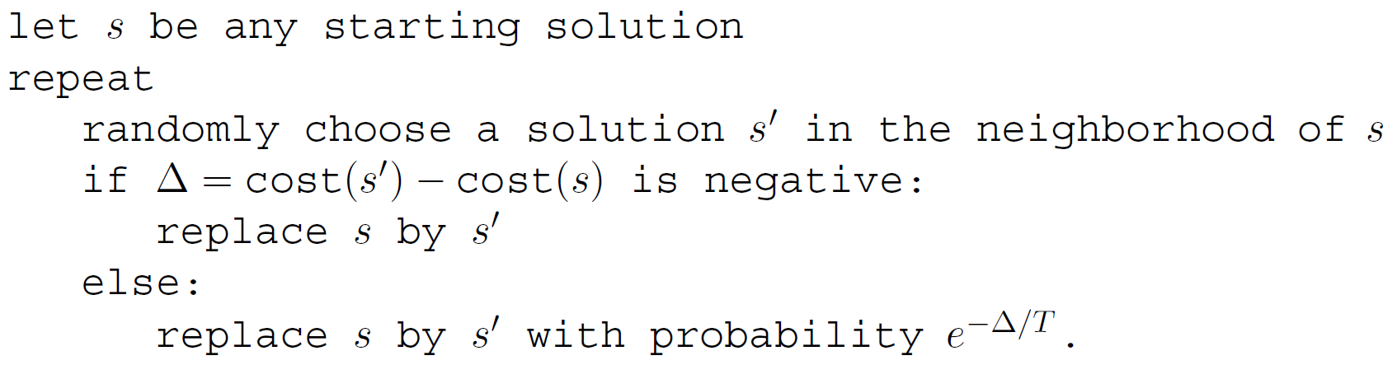
Dealing with local optima
When there are too many local optima, simply repeating the local search a few times is ineffective.
Simulated Annealing: mimics the physics of crystallization.
Occasionally allow worse moves, in the hope that they will pull the search out of dead ends.

Slide 20
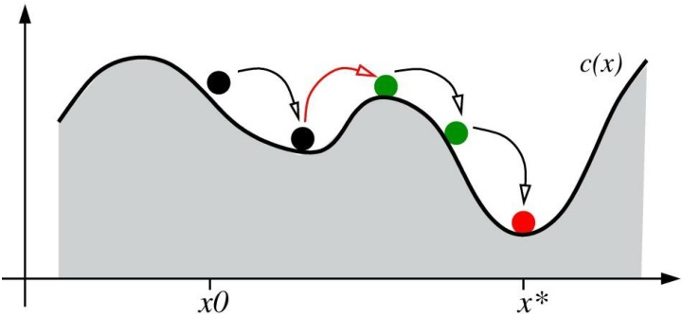
Dealing with local optima
When there are too many local optima, simply repeating the local search a few times is ineffective.
Simulated Annealing: mimics the physics of crystallization.
Occasionally allow worse moves, in the hope that they will pull the search out of dead ends.

